Slide 1
Colorado Sales Performance Analysis
West Region | 2022–2025
Cassandra Soto

Slide 2
Agenda
01
Business context & scope
02
Summary statistics
02
03
Territory vs. region
03
04
Sales trends & relationships
04
05
Findings & recommendations
05

Slide 3
A sales manager needs a clear growth plan
EmporiUm
THE ANALYTICAL BRIEF
• Measure the scale of the business
A fictional bookstore and retail chain offering textbooks, technology, art supplies, general books, and merchandise through physical stores and online sales.
• Compare Colorado with the West region
• Identify performance trends
• Recommend next-quarter actions

Slide 4
Company-wide revenue exceeds $113 million
TOTAL REVENUE
SALES RECORDS
AVERAGE RECORD
$113.37M
460,694
$246.10
In-store + online
Across both channels
Not necessarily receipt-level
REVENUE BY CHANNEL
In-store $45.37M
Online $68.00M
335,129 sales records
125,565 sales records

Slide 5
Colorado generated $6.41 million
REVENUE
SALES RECORDS
AVERAGE RECORD
$6.41M
46,498
$137.91
In-store sales, all four years
Across 18 stores
Sales-line average
Store leaders
SHARE OF COMPANY
#705 Denver
$917,471.53
5.7%
#709 Greeley
$640,368.11
of company-wide revenue

Slide 6
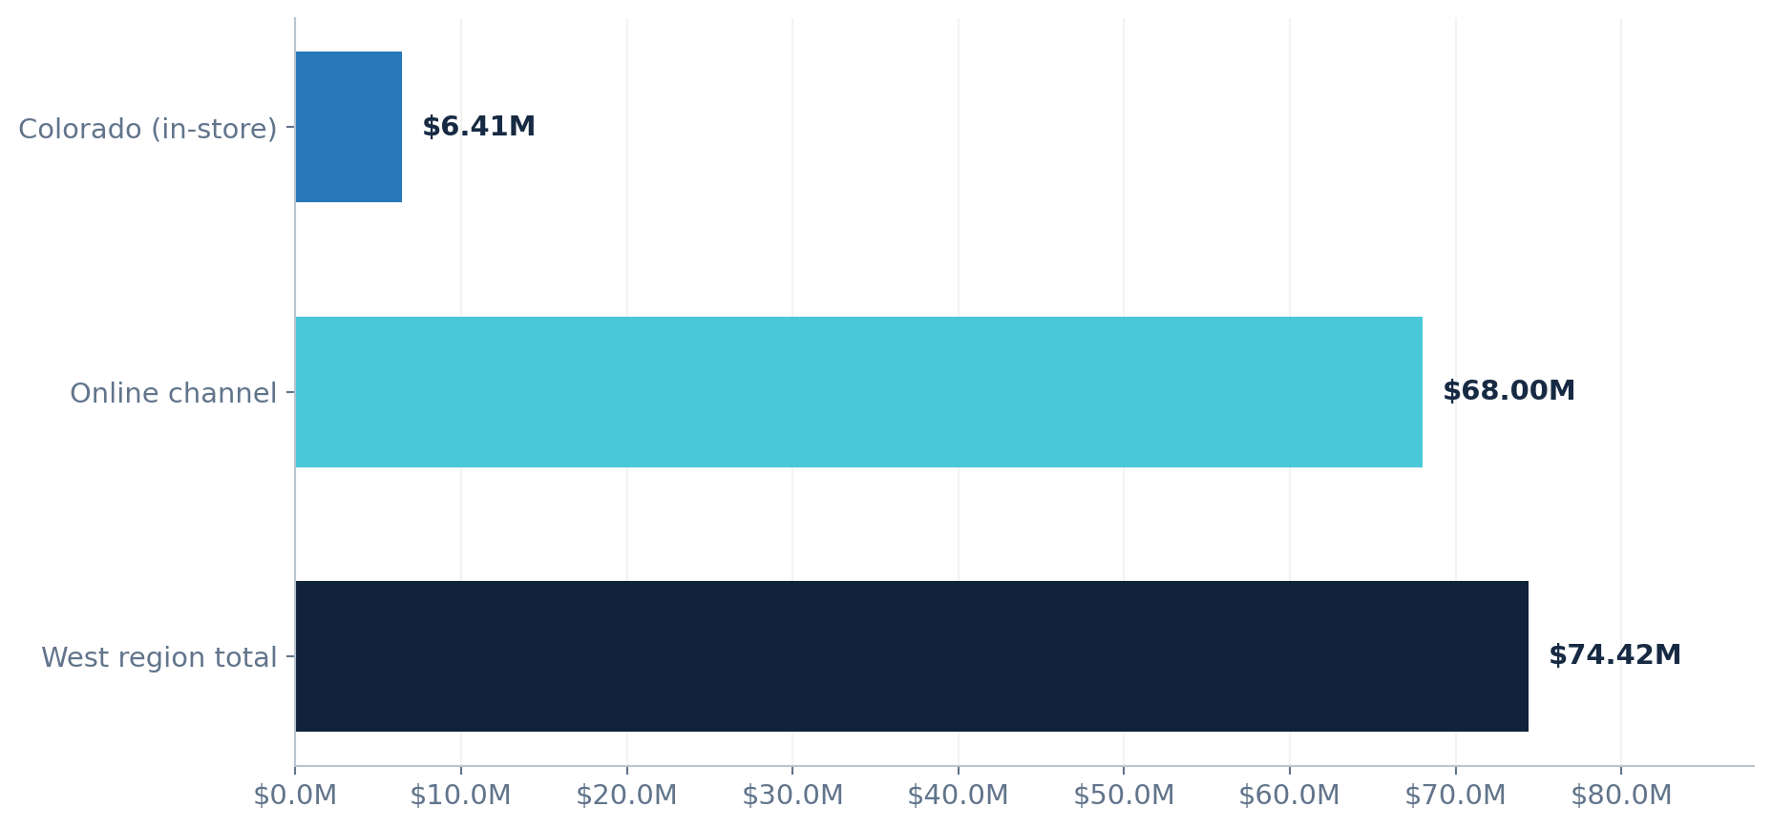
Online sales dominate the West region
COLORADO SHARE
OF WEST
8.6%

Slide 7
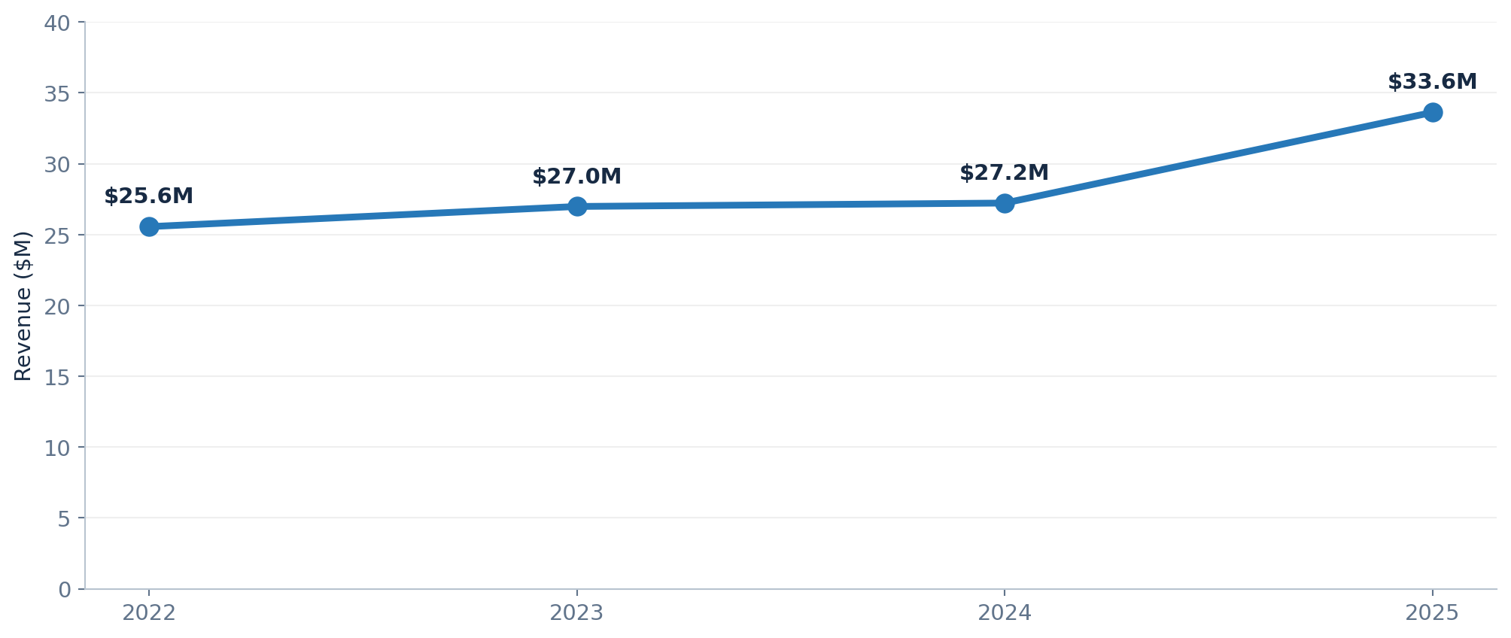
Company revenue accelerated in 2025
2025 VS. 2024
+23.5%
Revenue growth

Slide 8
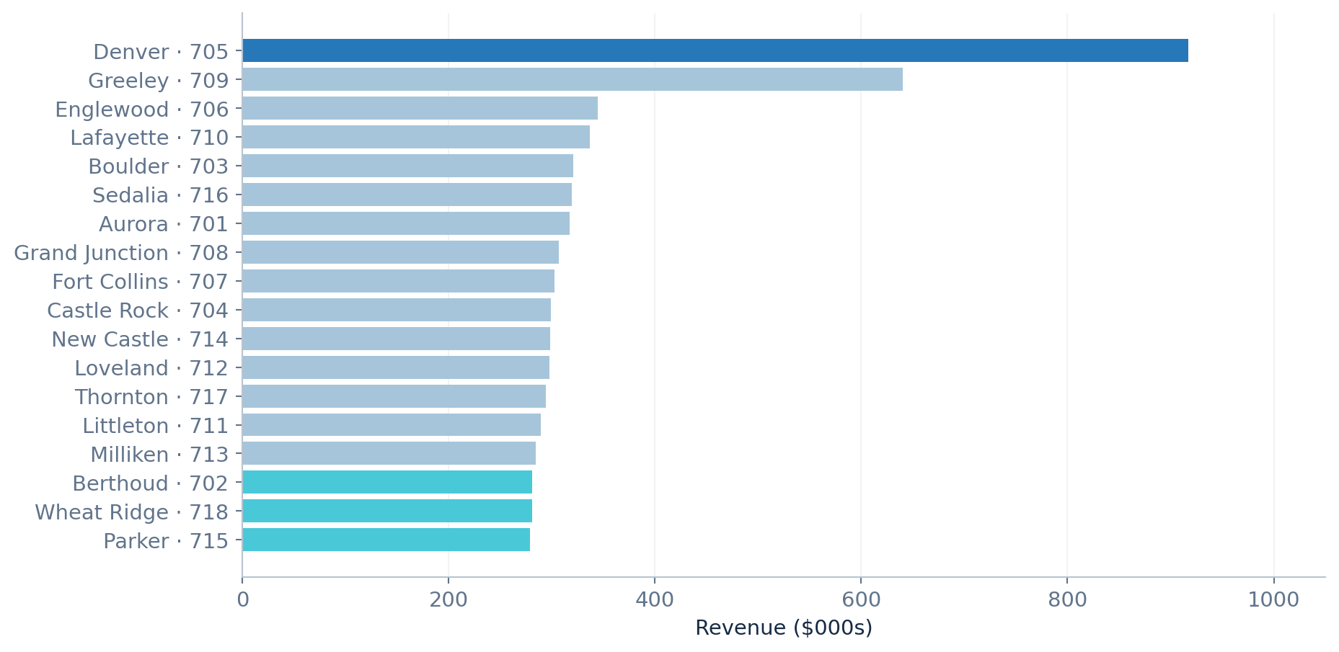
Focus on low-revenue stores and high-value categories
COLORADO STORE REVENUE RANKING
NEXT-QUARTER PRIORITIES
01
Review lower-revenue stores
Parker 715, Wheat Ridge 718, Berthoud 702
02
Learn from leading stores
Compare Denver 705 and Greeley 709 operating practices
03
Review product mix
Technology drives ~71% of Colorado revenue

